Slide 1

ARIANE Flight 501
The Mavasian
Presenter’s Name: Raghad Safauldeen
Project Manager
The Project Team 6:
Francis Le Nhi Luong
Quy Pham
Raghad Safauldeen
CSE-4322 – Software Project Management
Spring 2019

Slide 2
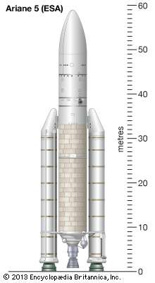
Agenda
Introduction
What is ESA?
Description of Ariane 5
The Nature Of Failure
Project Management Difficulties
Demo
Project Schedule
Summary
References

Slide 3
Introduction
The European Space Agency(ESA) is a commercial space business who built the Ariane 4 (over 20 years of service) with over 100 success launch without failure.
The Ariane 5 took 10 years and $7 billion to develop it. The destroyed rocket valued was $500 million.
The Ariane 5 team reused Ariane 4 software for navigation and flight path optimization libraries.

Slide 4


What is ESA?
European Space Agency (ESA) is European space and space-technology research organization founded in 1975 from the merger of the European Launcher Development Organization (ELDO) and the European Space Research Organization (ESRO), both established in 1964.
Headquarters of the agency are in Paris. ESA members are: Austria, Belgium, the Czech Republic, Denmark, Estonia, Finland, France, Germany, Greece, Hungary, Ireland, Italy, Luxembourg, the Netherlands, Norway, Poland, Portugal, Romania, Spain, Sweden, Switzerland, and the United Kingdom.

Slide 5
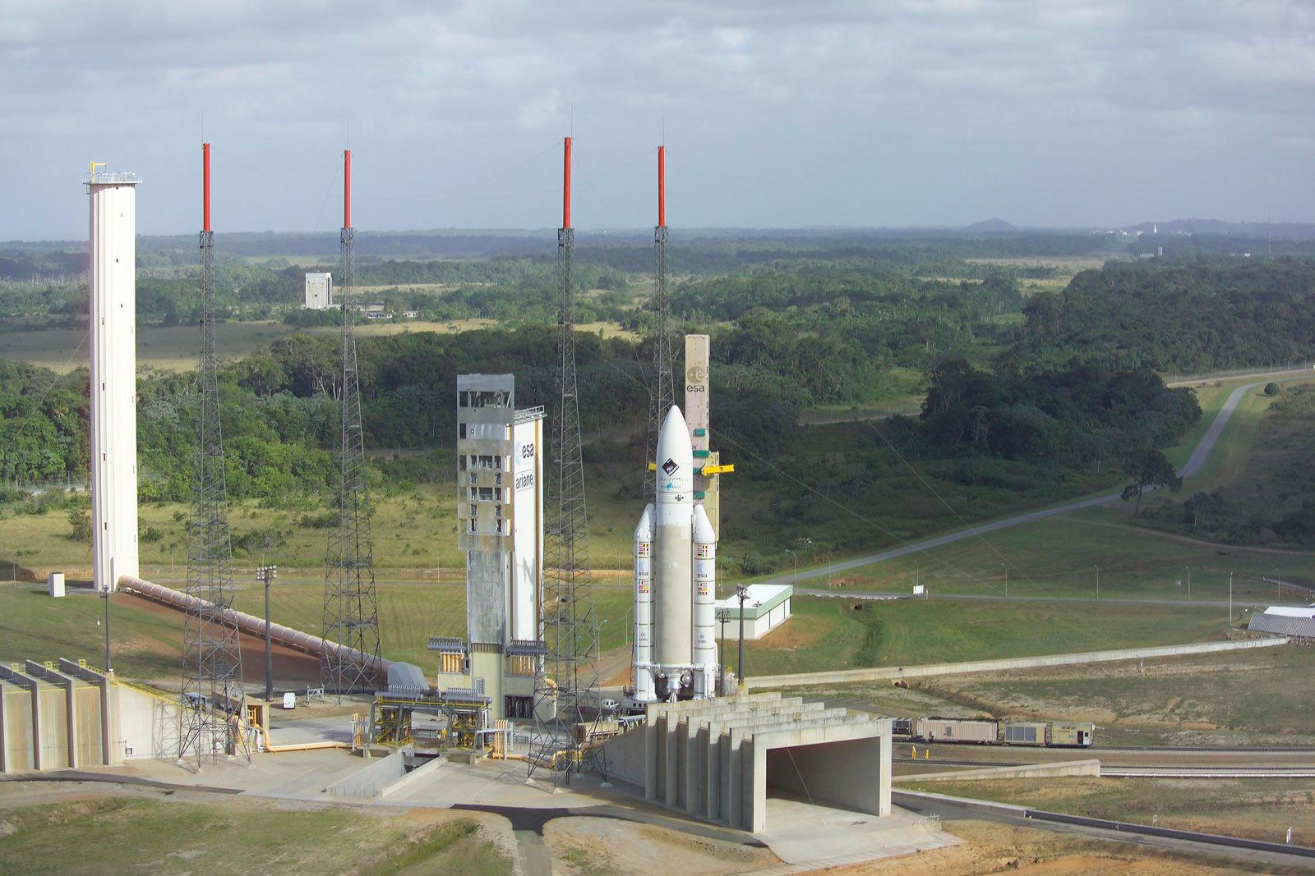
What is ESA? (cont.)
The European Space Agency has cooperated with the U.S. National Aeronautics and Space Administration (NASA) on many projects. ESA developed the Ulysses spacecraft (launched 1990) to explore the Sun’s polar regions and the Ariane series of launch vehicles.

Slide 6
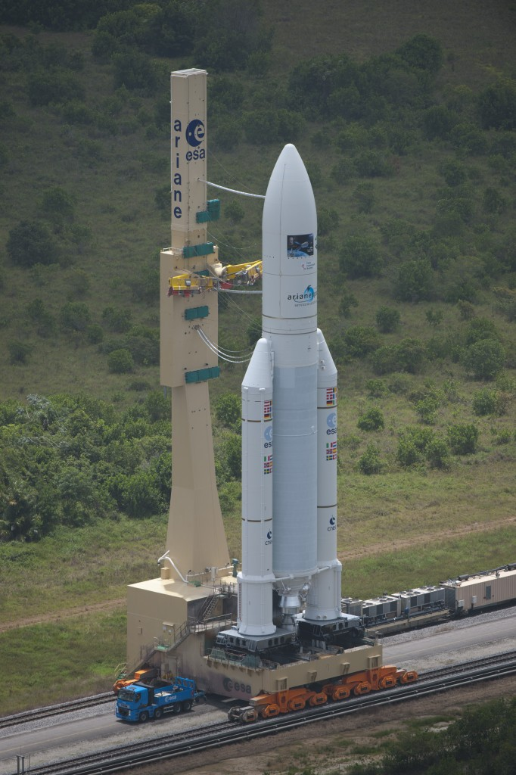
Description of Ariane 5
In 1985 the ESA, decided to develop Ariane 5 with a new design based on a cryogenically fueled first stage, flanked by two large solid-fuel boosters, and having a second stage fueled with nitrogen peroxide as the oxidizer.
With a much more powerful upper stage than previous Ariane models, the Ariane 5 is capable of carrying a 23,100-pound satellite to geostationary orbit.

Slide 7
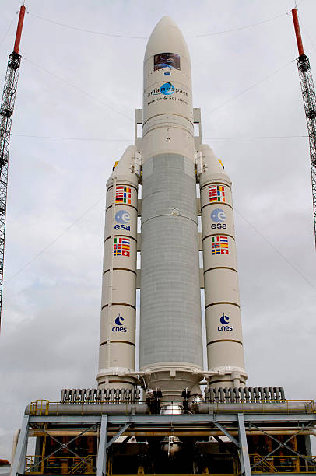
Description of Ariane 5 (cont.)
The first test launch of the Ariane 5, in June 1996, was failure, but in subsequent years the vehicle operated reliably.
Since the Ariane 4 was retired from service in 2003, all ESA launches have used Ariane 5, and there has been a continuing effort to lower its costs and improve its reliability and performance, particularly its ability to launch two communications satellites with weight of 21,000 pounds to geostationary orbit.

Slide 8
The Nature of the Failure
The Nature of the Failure is Human error.
The failure was base of the fact that the engineers did not take in account of the speed of Ariane 5
The number of the speed cannot be represent in 16-bit signed integer like in Ariane 4, that lead to overflow problem in the computer computation.
The back-up system does not work because it was also 16-bit

Slide 9
Project Management Difficulties
The fail in Ariane 5 project raises many questions about the management team, for example.
Did the team does good job in selecting the platform?
Did they do risk management evaluation?
Did they do enough testing?
Did their team communicate effectively?
If those questions are address properly within the management team, the problem could be avoided.
The lesson learnt from this incident is, if one thing worked on the old system, may not necessarily work on the new one

Slide 10

Demo https://www.youtube.com/watch?v=PK_yguLapgA

Slide 11
Project Schedule
Task Name | Assignee | Est.Start Date | Actual Start Date | Est. Complete Date | Actual Complete Date | Est. Hours | Actual Hours
Project plan | Raghad | 1/24/2019 | 1/24/2019 | 1/25/2019 | 1/26/2019 | 2 | 3
Introduction (brief history, company name, back ground) | Francis | 1/24/2019 | 1/25/2019 | 1/28/2019 | 1/27/2019 | 3 | 2
Identify and describe the project, company’s mission/intended use | Raghad | 1/25/2019 | 1/26/2019 | 1/28/2019 | 1/28/2019 | 8 | 9
describe the nature of the failure and project management difficulties | Nhi | 1/30/2019 | 02/02/2019 | 2/1/2019 | 02/04/2019 | 6 | 3
Conclusion (how to avoid the problem, and what we learn) | Quy Pham | 1/24/2019 | 1/27/2019 | 1/28/2019 | 1/28/2019 | 7 | 5
PowerPoint | Raghad | 2/1/2019 | 2/1/2019 | 2/2/2019 | 2/5/2019 | 8 | 10
Practice presentation | Raghad | 2/2/2019 | 2/5/2019 | 2/5/2019 | 2/6/2019 | 5 | 5
Total |  |  |  |  |  | 36 | 37

Slide 12
Summary
In this century, software takes an important role in the development of technology. Besides many successful software, there have been some failed software. Ariane Flight 501 is a realistic example. This project was very promising, but the result was terrible. Therefore, to prevent any failure like Ariane Flight 501 from happening again, every software should be designed and tested carefully. Making good and safe software will guarantee a promising future and a better world.

Slide 13
References
Logsdon, John M. "Ariane" Encyclopædia Britannica. November 20, 2017
https://www.britannica.com/technology/Ariane-European-launch-vehicles
The Editors of Encyclopaedia Britannica. "European Space Agency" Encyclopædia Britannica. Encyclopædia Britannica, inc. January 22, 2019
https://www.britannica.com/topic/European-Space-Agency
The Editors of Encyclopaedia Britannica."European Space Agency" Encyclopædia Britannica. Encyclopædia Britannica, inc.January 22, 2019
https://www.britannica.com/topic/European-Space-Agency
Google image. 2018. “Fly to the space with the internship of the European Space Agency.”
http://www.carriereinternazionali.com/en/europe/item/9098-space-internship-european-space-agency
Google image. 2008. "Space in Images"
http://www.esa.int/spaceinimages/Images/2008/03/The_Ariane_5_ESATV_launcher_on_its_mobile_launch_table3

Slide 14
Q&A

Slide 15


